Slide 1

CEIS106: INTRODUCTION TO LINUX
By Kassandra Moreno

Slide 2




Introduction
Throughout this course I have learned the concepts of operating systems through Linux. Linux is currently in the top operating systems used today and can prove to be beneficial knowledge in our growing workforce. In this course I learned: filesystem hierarchy, shell scripts, user and group management, network configuration, and system performance monitoring through Linux.

Slide 3



Agenda
Linux Filesystem Hierarchy
Linux Shell Scripts
User and Group Management
Network Configuration
System Performance Monitoring

Slide 4

Linux Filesystem Hierarchy
Navigating the Linux filesystem tree
Creating directories and files
Copying and removing directories and files
Locating directories and files

Slide 5
Navigating the Linux filesystem tree
Good things to know:
Commands that will save you:
“pwd” (print work directory)
Tells you where you are
“cd ” (change directories)
“cd ~” Takes you right back to the home directory.
“cd ..” Moves you one directory up
“cd -” Moves you to you previous directory
“ls” (list)
Will list the files in the directory you are currently in.
“ls -l” outputs the “long list” which will give you more details on the files in the listing
The difference between relative and absolute pathes:
A relative path would be a path within the same directory, while an absolute path would be a math located at the root. The difference could be compared to getting a street address instead of a global address.
[relative path: 124 Conch Street]
[absolute path: 124 Conch Street, Bikini Bottom, Pacific Ocean]

Slide 6
Creating directories and files
“mkdir” (make directory)
To create a new directory, you can use the command “mkdir” followed by the name you want to give the file. (No spaces!)
mkdir TardisDown
To create folders within the directory, you have to enter the new directory with the “cd” command then use the “mkdir” command again. (No spaces)
cd TardisDown
mkdir callTheDoctor
mkdir goodbyeGallifrey
To enter files into the callTheDoctor folder you have to enter the folder with the “cd” command then use the “touch” command followed by the file names. (No spaces!)
Cd callTheDoctor
touch fileChameleon fileCircuit fileBroken
To ensure your directory, folders, and files are created you can use the “tree” command.
tree -d -L 2 ~
(the above input gives you the complete view of the home directory tree and verifies the existence of new subdirectories)
l-s -l ~/TardisDown/callTheDoctor
(the above command show you the files found in the callTheDoctor folder)

Slide 7
Copying and removing directories and files
“cp -r”(recursive copy) AND “rmdir” (remove directory)
To create a subdirectory that contains a recursive copy of all subdirectories and files of another folder use the “cp -r” command.
cp -r TardisDown badWolf
To ensure your directory, folders, and files are created you can use the “tree” command.
tree TardisDown badWold
If you want to remove a folder from your new directory use the “rmdir” command.
rmdir badWold/goodbyeGallifrey
If you want to remove a file from your directory use the “rm” command.
rm badWolf/callTheDoctor/fileBroken
To ensure your directory, folders, and files are created you can use the “tree” command.
tree TardisDown badWold

Slide 8
Locating directories and files
“find ~ -iname” (search for files and directories)
The following command will look for directories whose name starts with “tardis” in the home directory.
Find ~ -iname tardis* -type d
The following command will look for the files in your home directory that incluse the word “file”
Find ~ -iname file*
To look for directories and files whose names contain a certain word type the command below folled by the word you are looking for.
locate -i
To search for an exact directory or file use the -r command. Example:
locate –r callTheDoctor$

Slide 9
Linux Shell Scripts
Navigating Linux shell scripts
Create a shell script
Change script file permissions
Set the PATH variable
Make the PATH variable permanent

Slide 10
Navigating Linux shell scripts
Good things to know:
Permissions. Permission order will be owner, group, and other.
Permission options are read, write, and execute
“>>” takes the output and appends it to a different file.
PATH contains a list of directories. PATH is used when a command or script is called without a pathname.
Changes to a PATH variable does not carry over from one shell window to the next, you must make the PATH variable permanent for this to happen.
7 | rwx | 111
6 | rw- | 110
5 | r-x | 101
4 | r-- | 100
3 | -wx | 011
2 | -w- | 010
1 | --x | 001
0 | --- | 000

Slide 11
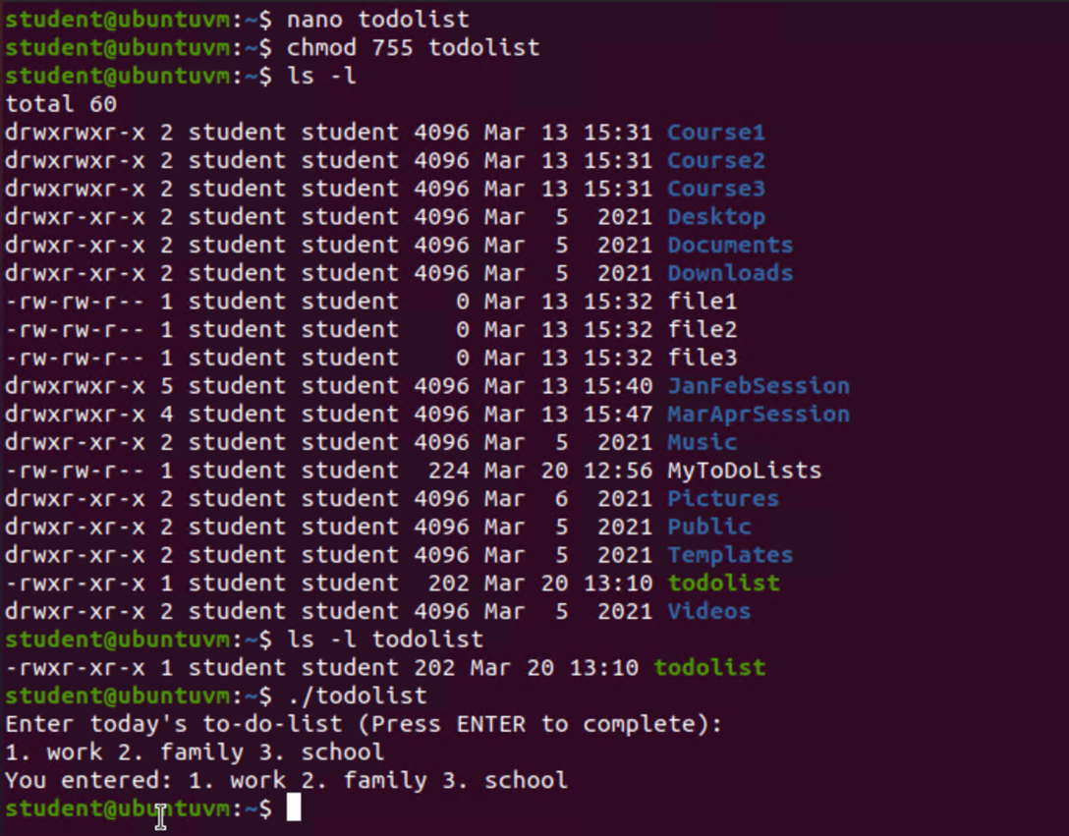
Create a shell script
“nano” (creates a shell script)
To create a shell script you will create a file using an editor. In this case we will be using nano and following the command with the title.
nano todolist

Slide 12
Change script file permissions
“chmod” (change file permission)
To change the script permissions so that the owner will have rwx, and the group and others will have xr enter:
chmod 755 todolist
Please refer to the table in slide 10 for permissions table guide.
To verify file permissions, use the long list command.
ls -l

Slide 13
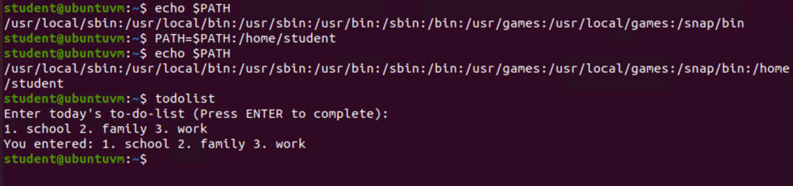
Set the PATH variable
“PATH=$PATH” (sets a new PATH variable)
To display current directories, enter:
Echo $PATH
To add your home directory where your “todolist” script is located as a PATH variable enter:
PATH=$PATH:/home/student

Slide 14
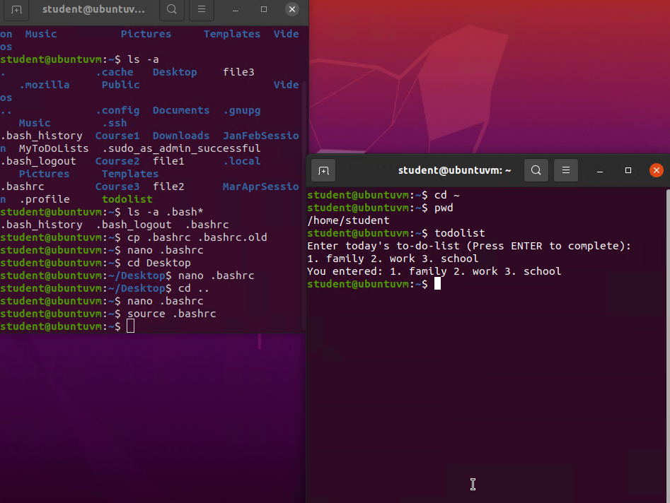
Make the PATH variable permanent
“.bashrc” (hidden file running behind every terminal window)
To list the .bashrc file, enter:
ls -a .bash*
To make a copy of the file, enter:
Cp .bashrc .bashrc.old
Incase you need to reverse changes
To edit .bashrc enter:
Nano .bashrc
To add your todolist as a permanent varible, enter:
Export PATH=$PATH:/home/student
To activate this PATH change, enter:
Source .bashrc

Slide 15
User and Group Management
Navigating user and group management
Add users and groups in CLI
Test user and group settings
Add users in GUI
Remove users and groups

Slide 16

Navigating User and Group Management
Good things to know:
Groups are created so that permission and access management could be managed more efficiently
-m under the useradd command creates a home directory
-3 under the tail command shows the last three lines of a file
When managing users and groups, work under a super user account (sudo)

Slide 17
Add users and groups in CLI
“useradd” (add a user)
To add a user, first ensure that you are in your home directory
cd ~
To accomplish adding a user while under a super user account enter:
sudo useradd -m -s /bin/bash mary
You will have to know the sudo user password to move forward
To establish a password for Mary enter:
sudo passwd mary
To create a group called students, enter:
Sudo groupadd students
To add your user account (student) AND Mary to the “students” group, enter:
sudo usermod -a -G students student
Sudo usermod -a -G students mary

Slide 18
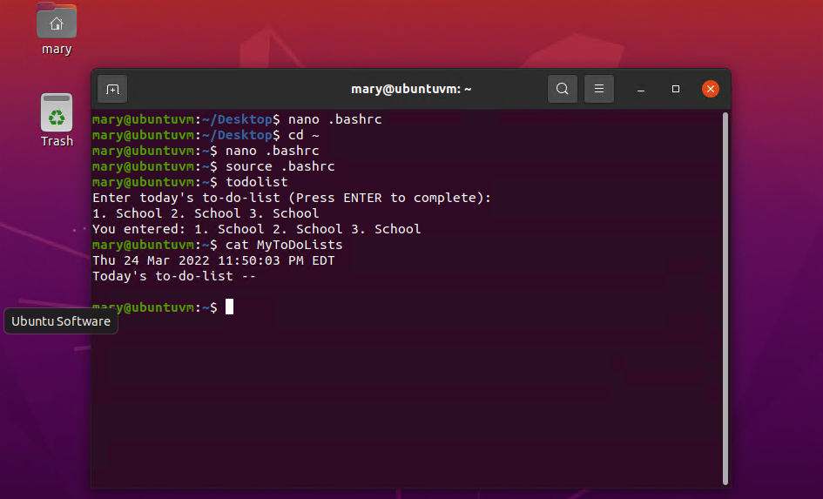
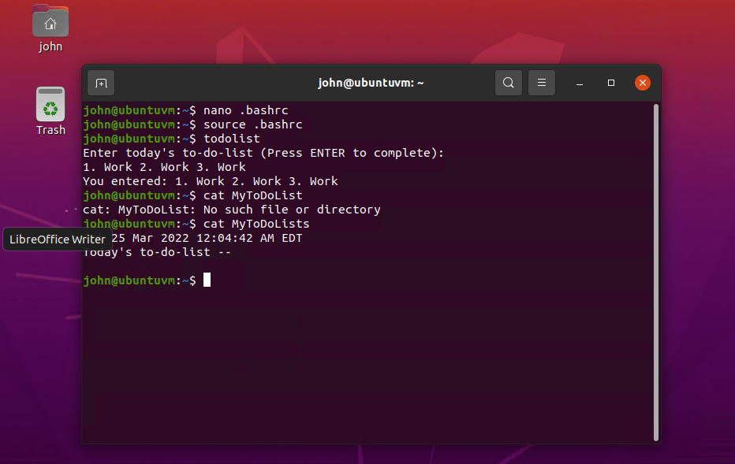
Test user and group settings
Ensure you are at your home directory with “cd ~”
To give the “students” group ownership of the todolist scripts, enter:
Sudo chgrp students todolist
To modify file permissions of the todolist script so that users in the same group can read and execute, enter:
Sudo chmod 750 todolist

Slide 19
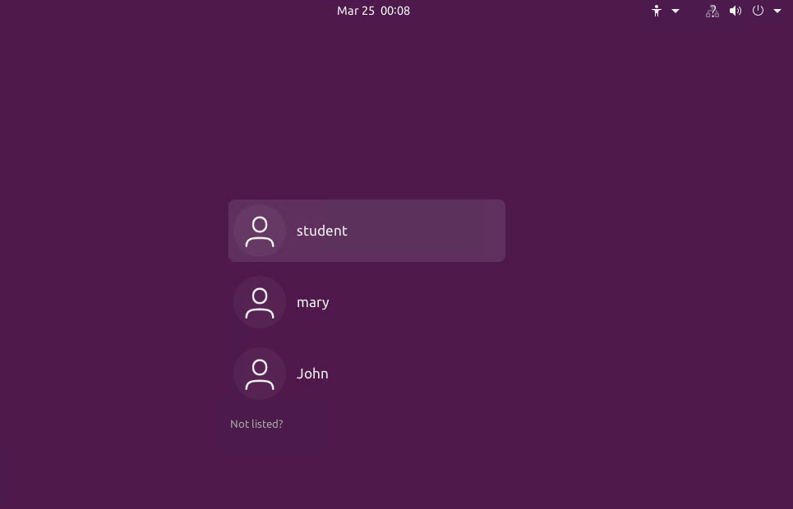
Add users in GUI
Using your graphical user interface (GUI)
on UBUNTU
Go to your applications
Click on users and groups
Click add
To create a user names “John” enter:
john
Enter John’s password
If you want to add john to the “students” group:
Highlight john on the user list and click manage groups
Select the “students” group
Under the properties button check “John” on the Groups Members list and select ok

Slide 20
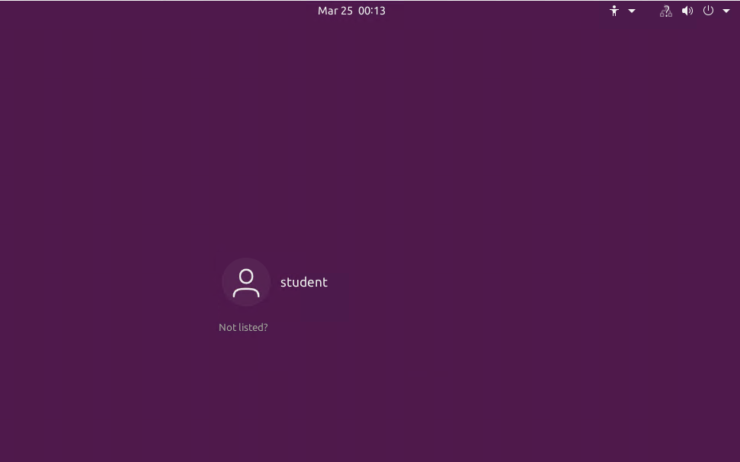
Remove users and groups
“userdel” (deletes users)
Ensure you are at your home directory with “cd ~”
To delete users Mary and John, enter:
sudo userdel -r mary
sudo userdel -r john
To delete the “students” group, enter:
sudo groupdel students
To change the group ownership of the todolist back to your primary user (student), enter:
sudo chgrp student todolist

Slide 21
Network Configuration
Navigating network configuration
Discover host IP configurations
Manage Network Interfaces
User Network Utilities

Slide 22

Navigating Network Configuration
Good things to know:
“ip addr” displays all IP addresses assigned to all network interfaces
“ip route” identifies the default gateways IP address after the via designation

Slide 23
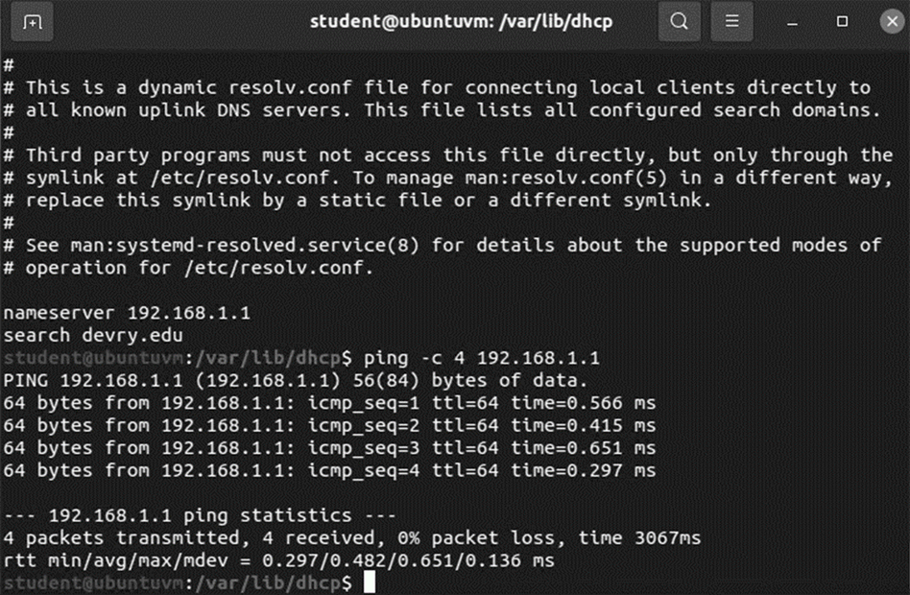
Discover host IP configurations
1. What is the IP address of your Ubuntu machine?
192.168.1.104/24
2. What is the IP address of its default gateway?
192.168.1.1
3. What is the IP address of its DHCP server?
192.168.1.1
4. What is the IP address of its DNS server?
192.168.1.1

Slide 24
Manage Network Interfaces
“Ip” (internet protocol address)
To display all network interfaces, enter:
Ip link
To disable/deactivate or enable/activate the eth0 interface, enter
Disable/ deactivate
sudo ip link set eth0 down
Enable/ activate
sudo ip link eth0 up
To view if eth0 interface is enabled or disabled, enter:
Ip addr show eth0
The IP address of your network is negotiated with a DHCP by default. To release your current IP, enter:
sudo dhclient -v -r eth0
To proactively negotiate an IP address, enter:
ip addr show eth0

Slide 25
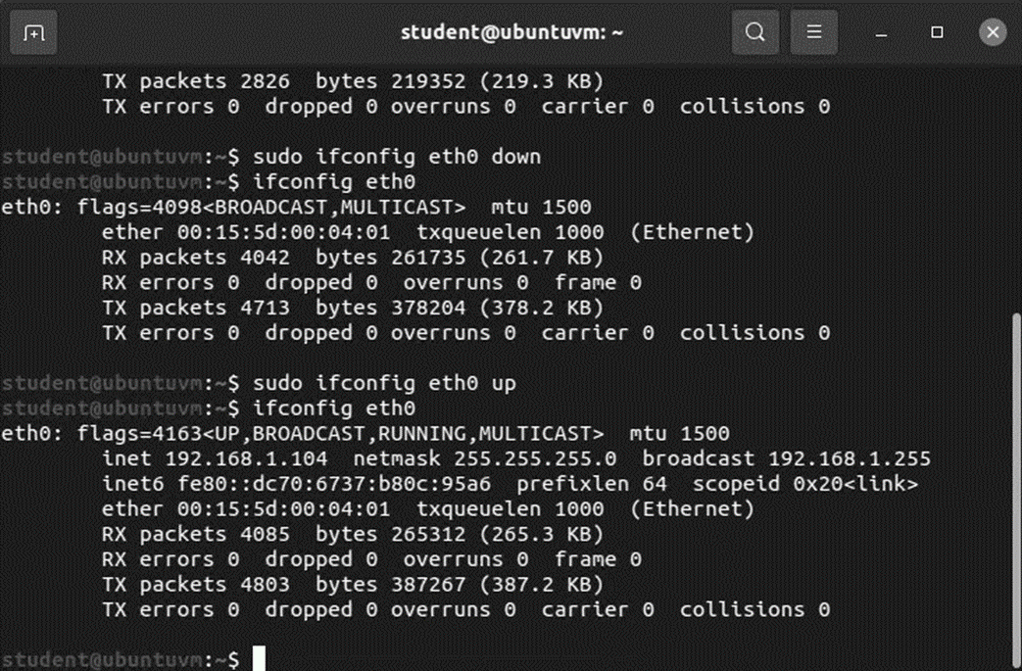
User Network Utilities
From your home directory (“cd ~”) display IP addresses assigned to all network interfaces
ifconfig
To disable/deactivate or enable/activate the eth0 interface, enter
Disable/ deactivate
sudo ifconfig eth0 down
Enable/ activate
sudo ifconfig eth0 up
To display status, enter:
ifconfig eth0

Slide 26
System Performance Monitoring
Navigating system performance monitoring
Monitor processes
Monitor user activities
Monitor network bandwidth usage

Slide 27

Navigating System Performance Monitoring
Good things to know:
The htop program monitors Linux processes in real time
The “ac” command displays information about a user connect time, in hours.
To display the results of a user’s connect time in days, enter:
ac -d
To view the connect time of each user per day, enter:
ac -dp
The iftop utility displays bandwidth usage on an interface by the host computer.

Slide 28
Monitor processes
By default, the 15 SIGTERM Kill signal will kill the highlighted process
In the system monitor window, entering the “%” key will sort the processes by CPU load. This is useful when finding the highest percentage usages in CPUs.
To launch htop, enter:
htop
To search for items in htop, enter “/” followed by what youre searching. Example:
/calculator
To end a process in the htop utility program, hignlight the rocess you want to end and select “End Process.”
To display previously executed commands, enter:
lastcomm htop
To view the number of processes and CPU minutes on a per-user basis, enter:
sa -m

Slide 29
Monitor user activities
Issue the sudo accton on command to turn on GNU accounting. Run the sudo updatedb command. Enter lastcomm updatedb to check if the updatedb command was executed before. Remember to turn off GNU accounting (sudo accton off) after answering the questions.
What flag value is displayed in the output?
S flag: meaning super user
Why is the name of the user who ran the processes shown as root, and not the current user??
Sudo was put in front of command which causes root user (super user) to execute command

Slide 30
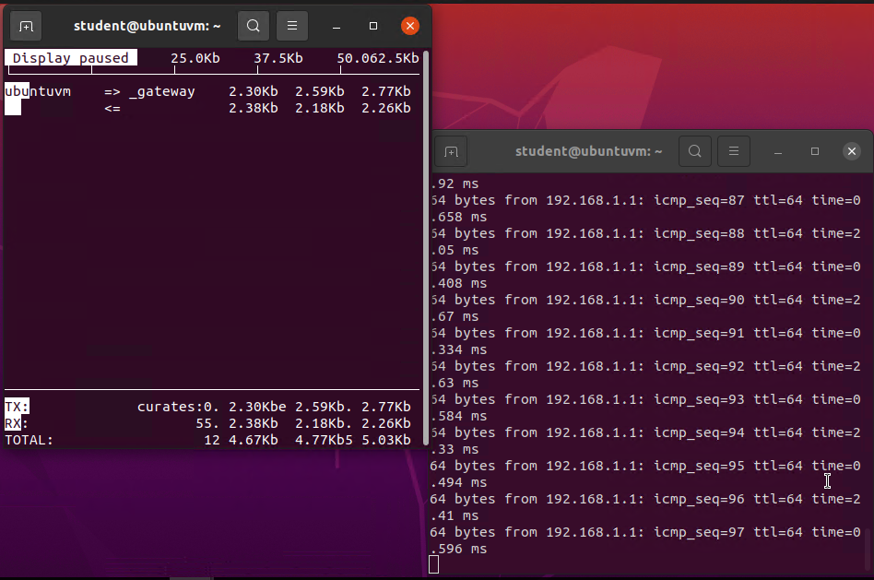
Monitor network bandwidth usage
“sudo iftop” launches the iftop utility.
Click in the iftop output windows and press ? to view a list of shortcut keys.
Open ANOTHER Terminal window and enter ping 192.168.1.1.
Click in the iftop output window and press the shortcut key upper-case P to pause the display.
The picture to the right displays the iftop monitor and the second terminal window.
The shortcut key n is pressed to toggle DNS reverse lookup on/off.
Source and destination IP addresses are displayed on the top right when the DNS resolution is off, and host names are displayed bottom right when the DNS resolution is on.

Slide 31

Summary
This course on operating systems has been an enjoyable journey. I went from knowing nothing about operating systems to learning how to navigate, monitor, and manipulate my system all through a command line! I truly enjoyed learning so much with hands-on experience on UBUNTU in such a short period of time. I am nowhere near an expert yet, but I am well on my way!

Slide 32


Thank You for following
By Kassandra Moreno

